Slide 1
Objective Functions of NONMEM®: FO method
Kyun-Seop Bae MD PhD
Department of Clinical Pharmacology and Therapeutics
University of Ulsan

Slide 2
NONMEM®
NONlinear Mixed Effects Modeling
F = function of (θ, η, Covariates)
Y = function of (F, ε)
θ: constant, η~MVN(0,Ω), ε~MVN(0,Σ)
Covariates are usually dose, time, demographics and other measurement (like laboratory) values.
Epsilon can express homoscedastic, proportional, exponential or combined errors.

Slide 3
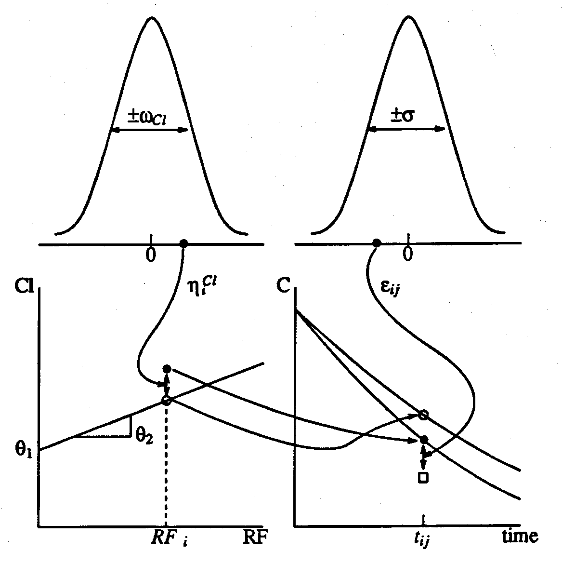
NONMEM Users Guide V, p40
Typical value of CL
( No interindividual random variability )
F: PRED
F: IPRE
Y: DV (observation)

Slide 4
Population Concept
We would like to know also SEs of estimates of
these parameters (θ₁ , θ₂ , θ₃ , ω₁ , ω₂ , σ ).
Cf) η₁ ,η₂ ,ε are not parameters, but random variables.
Typical Value of Population
Magnitude of Interindividual Random Variability
CL ~ N(θ₁+RFθ₂ , ω₁²) CL = θ₁ +RFθ₂ + η₁ , η₁ ~ N(0, ω₁²)
Vd ~ N(θ₃ , ω₂²) Vd = θ₃ + η₂ , η₂ ~ N(0, ω₂²)
COV(CL, Vd) = COV(η₁ , η₂) = ω₁₂ , η ~ N (0, Ω)
Y = F(CL, Vd, Dose, Time) + ε, ε ~ N(0, σ²)
F is 1) predicted value by typical values of PK parameter(θ)s (PRED)
or 2) random variable/value determined by PK parameter(θ)s
and interindividual random variability(η) (IPRE).

Slide 5
NONMEM® objective function 1, FO
NONMEM Users Guide I, p34-41
Total Objective Function
Individual Objective Function
Variance-Covariance Matrix
Weighted Residual (WRES)

Slide 6
NONMEM Objective Function, ELS = MLE
Difference between ELS and MLE: Whether to keep the assumption - normal distribution

Slide 7
G matrix in NONMEM®
Cf) $ABBREVIATED DERIV2=NO

Slide 8
Matrix^{-1/2}
not
Either inverse then square rooting(½) or square rooting(½) then inverse
Mx = function(M, x) # This is only valid for positive semidefinite matrix (PSD)
{
e = eigen(as.matrix(M))
return(e$vectors %*% diag(abs(e$values)^x) %*% t(e$vectors))
}
OR
"%^%" = function(M, x) with(eigen(M), vectors %*% (abs(values)^x * t(vectors)))
Example
M = matrix(c(2,1,1,2), nrow=2)
M%^%(-0.5)

Slide 9
RES vs WRES
Residual RES = Y – PRED RES = Y – F
WRES = C^{-1/2} %*% RES
Sign of WRES could be different from RES due to the matrix multiplication.

Slide 10
Taylor Series Expansion of Prediction Function
if

Slide 11
FO method
E(Y) ≈ F = PRED
V(Y) ≈ GΩG^{T} + diag(HΣH^{T})
Y ~ N(E(Y), V(Y))
RV_Normal + RV_Normal = RV_Normal, even if Cov is not 0.

Slide 12
F = PRED or IPRE
PRED: Typical prediction with eta=0 F0, F with eta=0
IPRE: Individual prediction with EBE F1, F with eta=EBE
EBE: maximum a posteriori (MAP), post-hoc eta, realized eta
RES (R0) = Y – PRED
IRES (R1) = Y – IPRE
where
F1, F0, G1, G0, H1, H0, R1, R0 1 means calculated with eta=EBE, 0 means calculated with eta=0

Slide 13
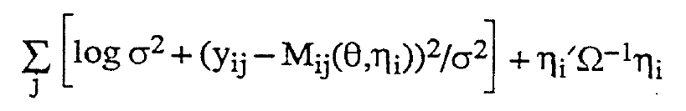
POSTHOC option
Empirical Bayes Estimate (EBE)
= Maximum A Posteriori (MAP)
= Realized Eta
= Post-hoc Eta
Ref. A Short Course by UCSF, 1993 OFV of FO cannot be calculated with ‘POSTHOC option and printed G values’, because printed G values are G1 not G0.

Slide 14
INTER option
With INTER option
Without INTER option (default)

Slide 15
NONMEM® 7.x OUTPUT files
*.coi: covariance inverse
*.cor: correlation matrix
*.cov: covariance matrix
*.cpu: CPU time
*.ext: iteration, total OFV
*.grd: gradient
*.phi: EBE, cov_EBE, individual OFVs
*.rmt: R matrix
*.shm: shrinkage
*.smt: S matrix

Slide 16
Demonstration using R Package nmw
>install.packages(“nmw”)
>library(nmw)
># Run scripts of the package manual for Theoph dataset.

